Slide 1
Does Poor Air Quality Increase Asthma Rates? Data Analysis of 2 U.S. States and Counties
Name: Anthony Zhong
University of Hawaii at Manoa – ECON 429
Instructor: Ashley Lowe Mackenzie
Date: October 5th, 2025

Slide 2
Premise
Air Quality Overview
Air quality is measured as an index ranging from 0 - 100, where higher values indicate worser conditions
The index includes pollutants such as particulate matter (PM2.5)
Focus
Examines asthma-related hospitalization and emergency room visits (per 10,000 people, ages 5-64) to explore the relationship between air quality and asthma
Hospitalizations: how often asthma flares become life-threatening
Emergency visits show how often asthma flares occur suddenly
Data Collected
Focus on comprehensive data provided by U.S EPA, U.S CDC, and DoH from the state of Massachusetts and Minnesota
Availability of county-level Asthma Data
Ease of public data assess and cleaning
Includes county population column
Reliable sources that collect through satellite

Slide 3
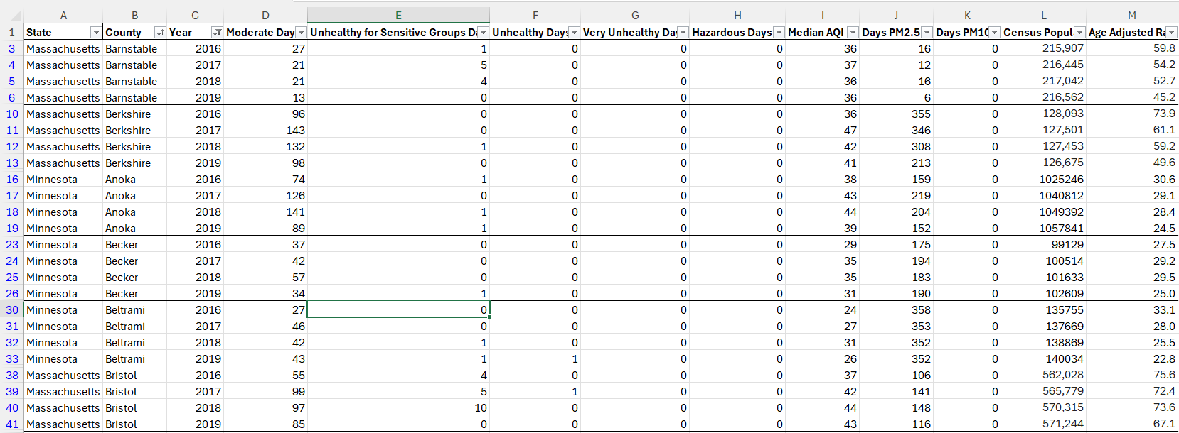
Table with Data-Ink Ratio Design Theory
Categorical: State, County, and Year (Ordinal)
Quantitative (Discrete): Moderate Day, Unhealthy Days, Hazardous Days, Median AQI, Days PM2.5, Days PM10, Census Population
Quantitative (Continuous): Age-Adjusted Rates

Slide 4
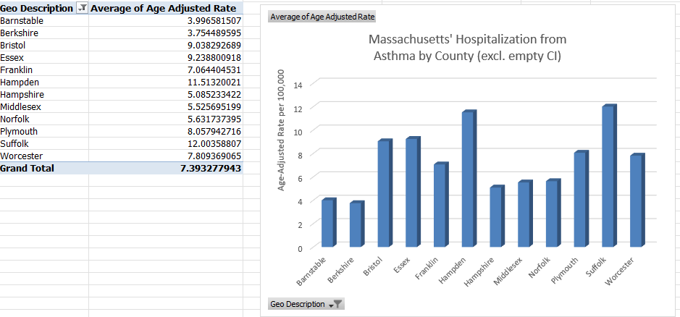
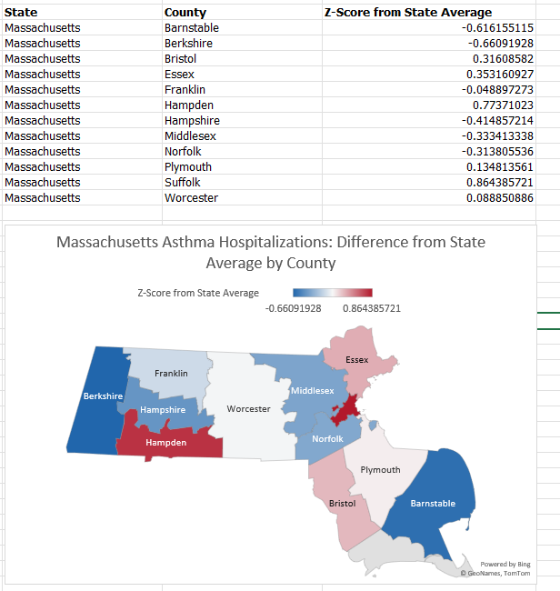
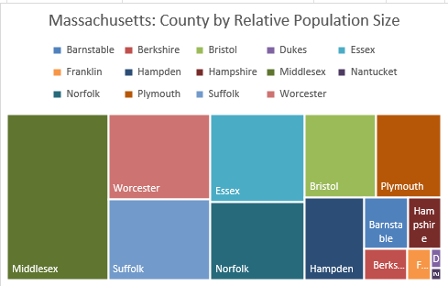

Slide 5
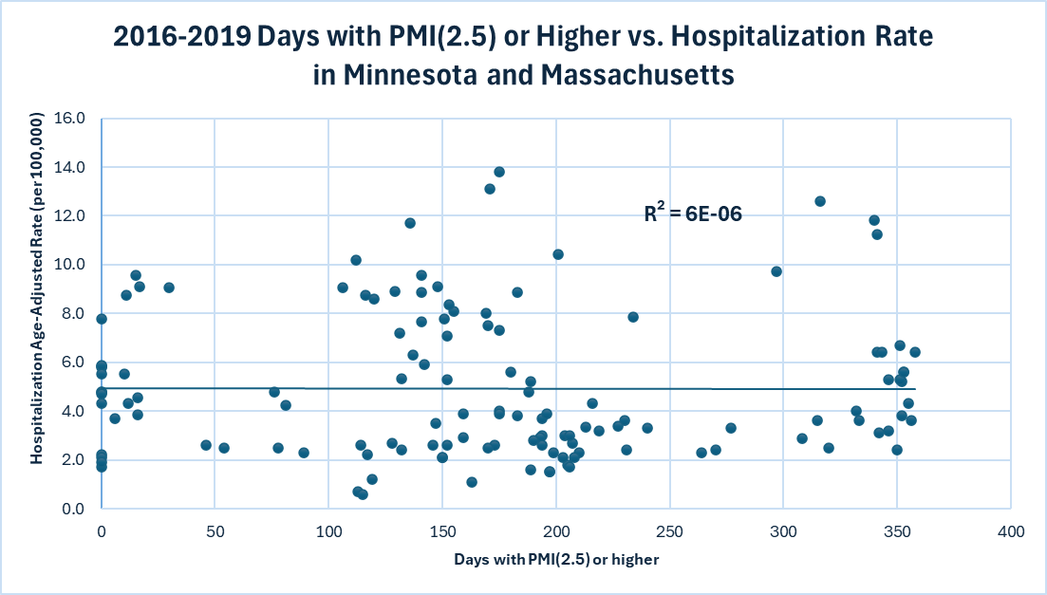
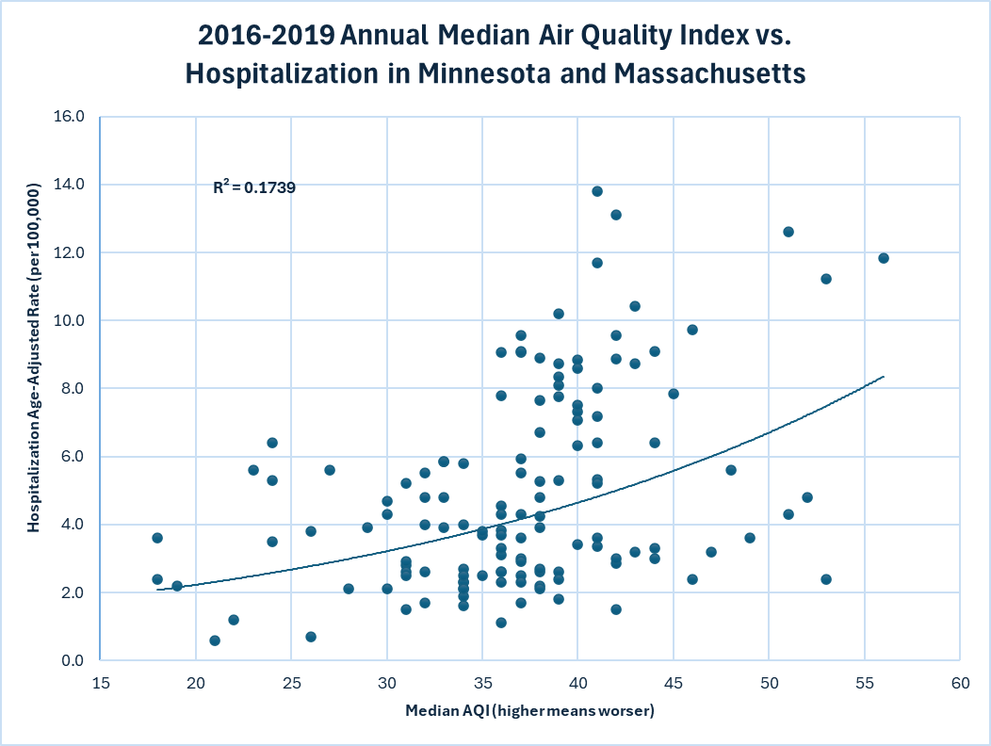
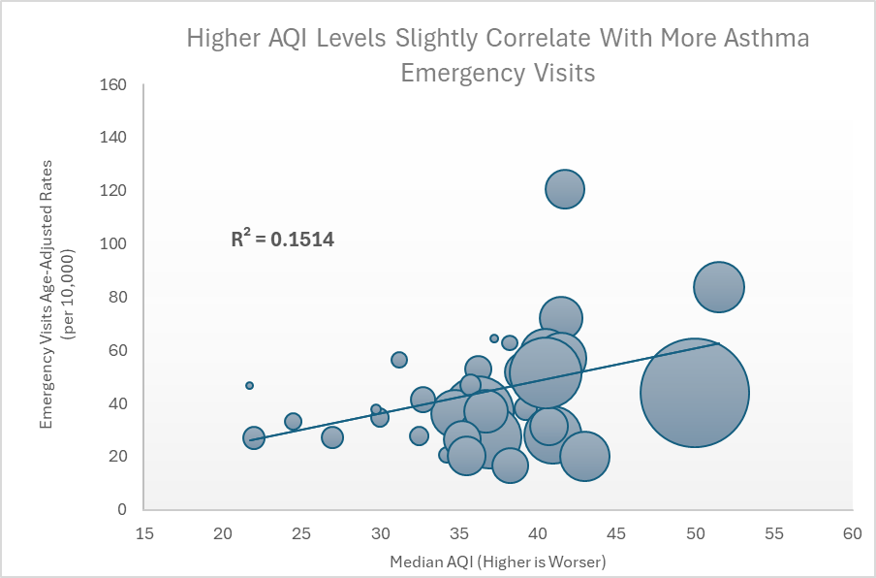

Slide 6
